Slide 1

WIS 2.0 Training Workshop, Windhoek, Namibia, 20-24 March 2023​
SYNOP to BUFR
Enrico Fucile
Head, Data and Information Management Division

Slide 2

SYNOP code form
Manual on Codes Vol. I.1
AAXX = fixed land station
BBXX = sea station
OOXX = mobile land station
Traditional Station Identifier (TSI)
YY = day of the month (no month, year)
GG = time of observations rounded at the nearest hour
i_{w} = units of wind speed and observed/estimated

Slide 3
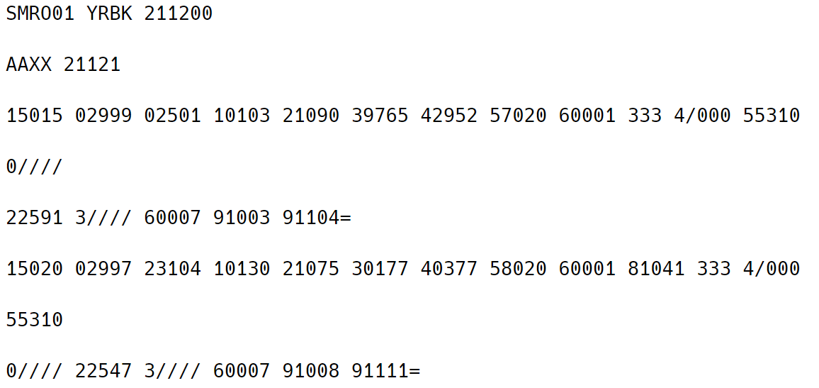
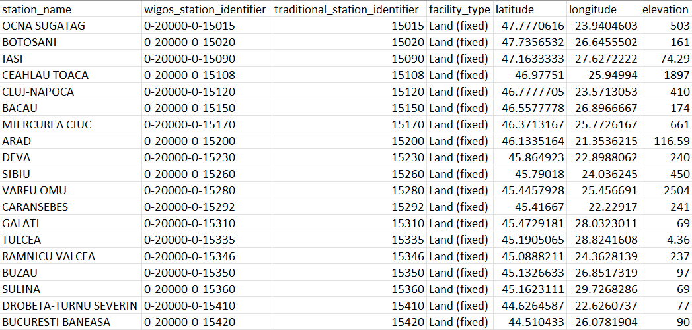
Example Files
SYNOP reports
Station list metadata
AAXX = fixed land station
YY = 21 of the month
GG = 12 hour of observation
iw = 1 Wind speed obtained from anemometer in m/s
TSI
TSI

Slide 4
SYNOP2BUFR Key Ingredients
SYNOP text file
Station list CSV file
synop2bufr
synop2bufr
https://github.com/wmo-im/synop2bufr
csv2bufr
pymetdecoder
csv2bufr
https://github.com/wmo-im/csv2bufr
pymetdecoder
https://github.com/antarctica/pymetdecoder
UK Research and Innovation (UKRI), 2021, British Antarctic Survey
BUFR file(s)

Slide 5
Conversion Command
synop2bufr transform
--metadata <station list CSV file> (default metadata.csv)
--output-dir <output location> (default current working directory)
--year <year of message> (default current year)
--month <month of message> (default current month)
<SYNOP text file>

Slide 6
Thank you
Merci

